Slide 1
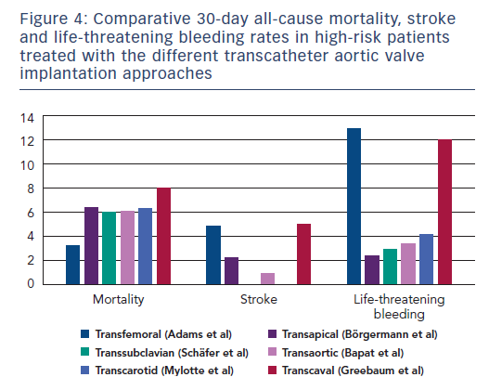
Overtchouk P, Modine T
Figure 4: Comparative 30-day all-cause mortality, stroke and life-threatening bleeding rates in high-risk patients treated with the different transcatheter aortic valve implantation approaches
Citation: Interventional Cardiology Review 2018;13(3):145–50
https://doi.org/10.15420/icr.2018.22.1

