Slide 1
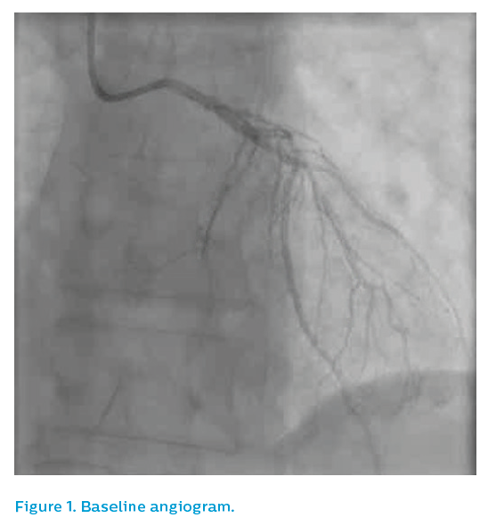
Sharp AS
Figure 1. Baseline angiogram
Citation: RadcliffeCardiology.com, September 2018
https://doi.org/10.15420/rc.2018.m015

