Slide 1
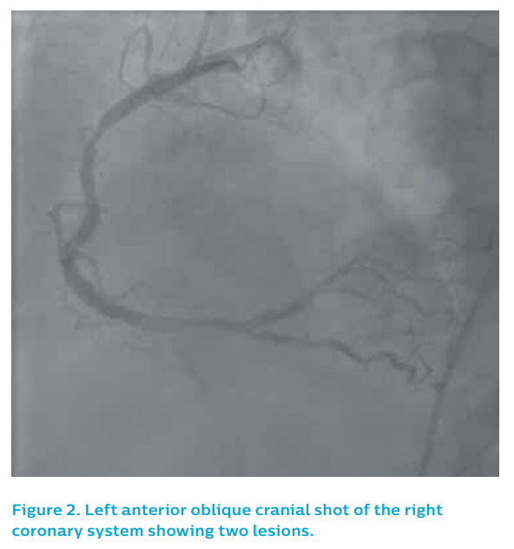
Sharp AS
Figure 2. Left anterior oblique cranial shot of the rightcoronary system showing two lesions
Citation: RadcliffeCardiology.com, September 2018
https://doi.org/10.15420/rc.2018.m015

