Slide 1
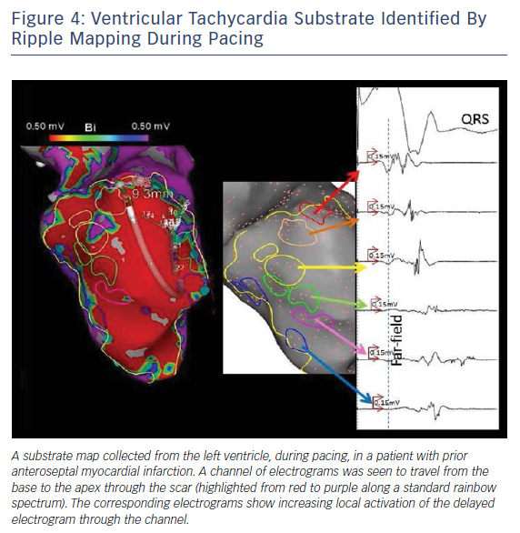
Katritsis GD, Luther V, Kanagaratnam P, Linton NW
Ventricular Tachycardia Substrate Identified By Ripple Mapping During Pacing
Citation: Arrhythmia & Electrophysiology Review 2018;7(4):261–4.
https://doi.org/10.15420/aer.2018.44.3

