Slide 1
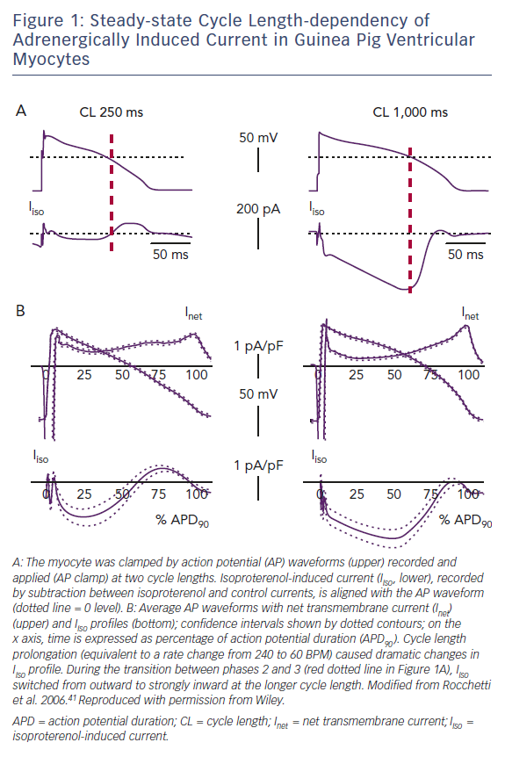
Zaza A, Ronchi C, Malfatto G
Steady-state Cycle Length-dependency of Adrenergically Induced Current in Guinea Pig Ventricular Myocytes
Citation: Arrhythmia & Electrophysiology Review 2018;7(4):232–7.
https://doi.org/10.15420/aer.2018.12.3

