Slide 1
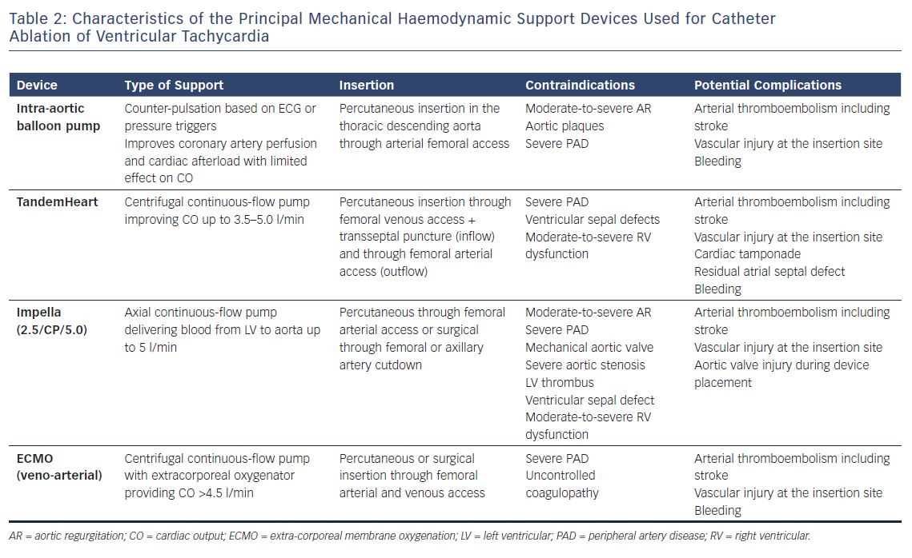
Muser D, Castro SA, Liang JJ, Santangeli P
Characteristics of the Principal Mechanical Haemodynamic Support Devices Used for Catheter Ablation of Ventricular Tachycardia
Citation: Arrhythmia & Electrophysiology Review 2018;7(4):282–7.
https://doi.org/10.15420/aer.2018.36.3

