Slide 1
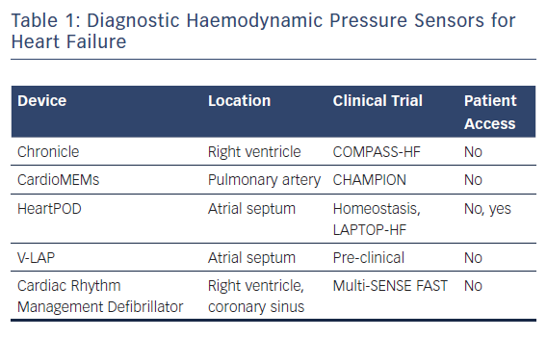
Raj LM, Saxon LA
Diagnostic Haemodynamic Pressure Sensors for Heart Failure
Citation: Arrhythmia & Electrophysiology Review 2018;7(4):294–8.
https://doi.org/10.15420/aer.2018.32.3

