Slide 1
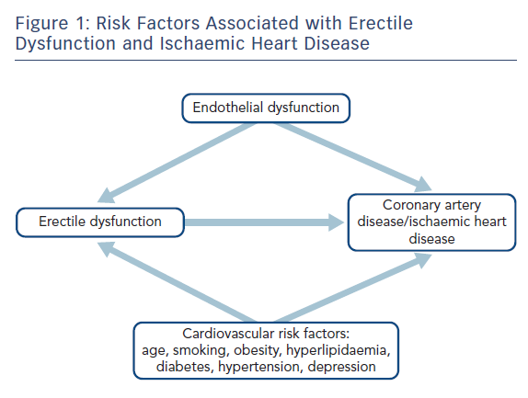
Ibrahim A, Ali M, Kiernan TJ, Stack AG
Risk Factors Associated with Erectile Dysfunction and Ischaemic Heart Disease
Citation: European Cardiology Review 2018;13(2):98–103.
https://doi.org/10.15420/ecr.2017.21.3

