Slide 1
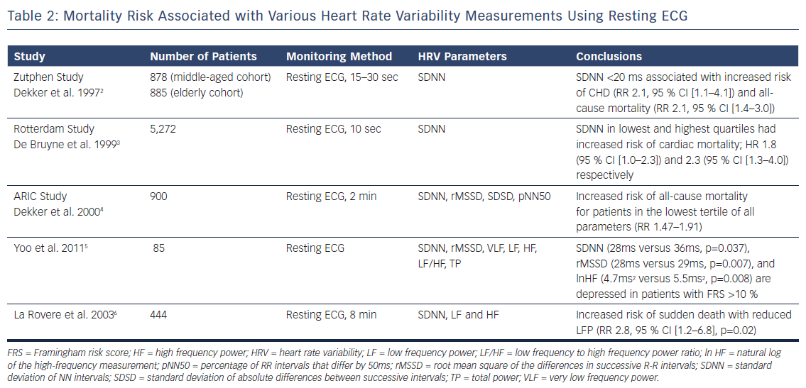
Singh N, Moneghetti KJ, Christle JW, Hadley D, Froelicher V, Plews D
Mortality Risk Associated with Various Heart Rate Variability Measurements Using Resting ECG
Citation: Arrhythmia & Electrophysiology Review 2018;7(4):247–55.
https://doi.org/10.15420/aer.2018.30.2

