Slide 1
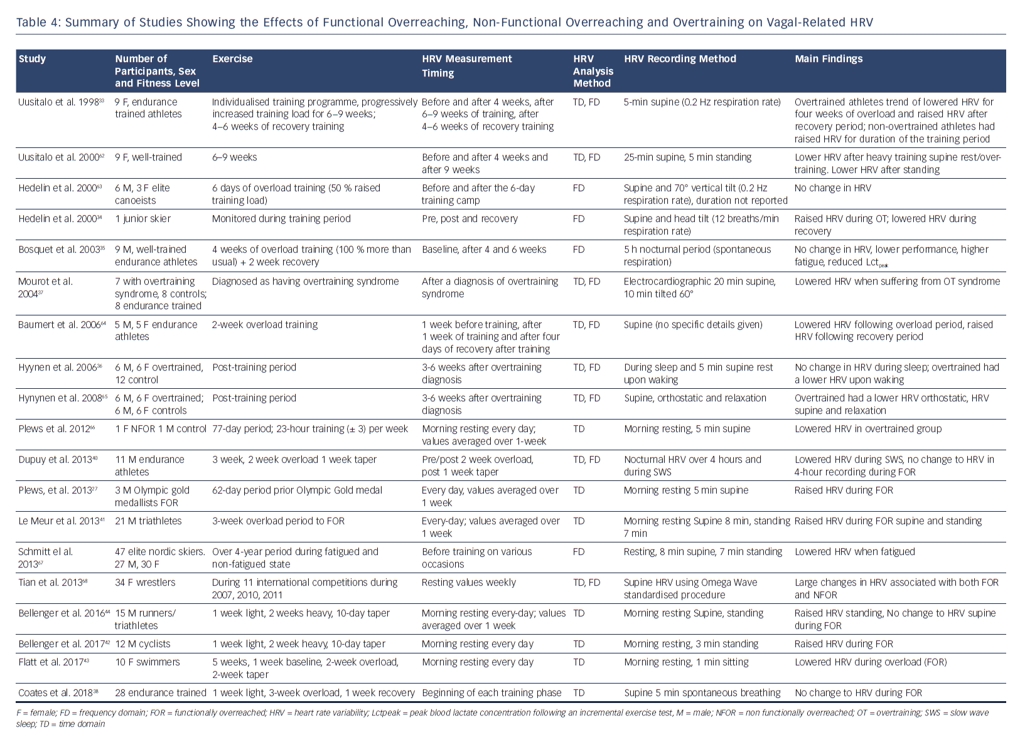
Singh N, Moneghetti KJ, Christle JW, Hadley D, Froelicher V, Plews D
Summary of Studies Showing the Effects of Functional Overreaching, Non-Functional Overreaching and Overtraining on Vagal-Related HRV
Citation: Arrhythmia & Electrophysiology Review 2018;7(4):247–55.
https://doi.org/10.15420/aer.2018.30.2

