Slide 1
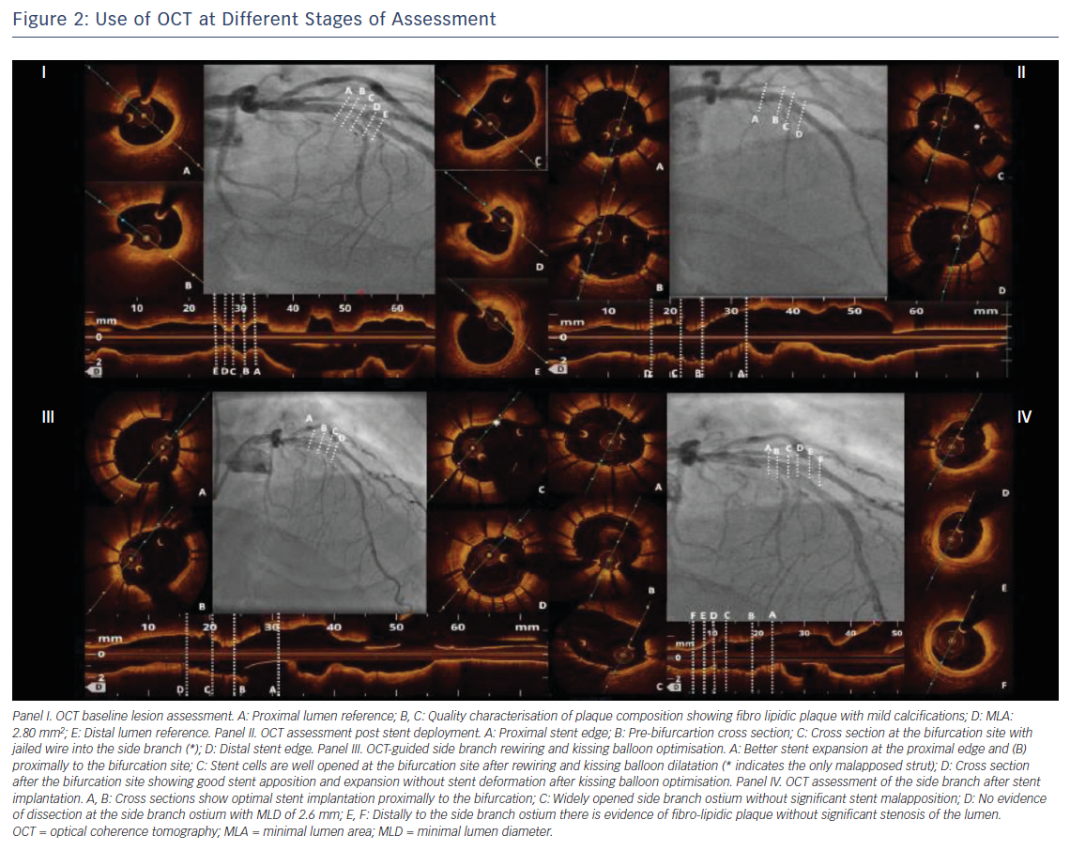
Longobardo L, Mattesini A, Valente S, Di Mario C
Use of OCT at Different Stages of Assessment
Citation: Interventional Cardiology Review 2019;14(1):5–9
https://doi.org/10.15420/icr.2018.17.2

