Slide 1
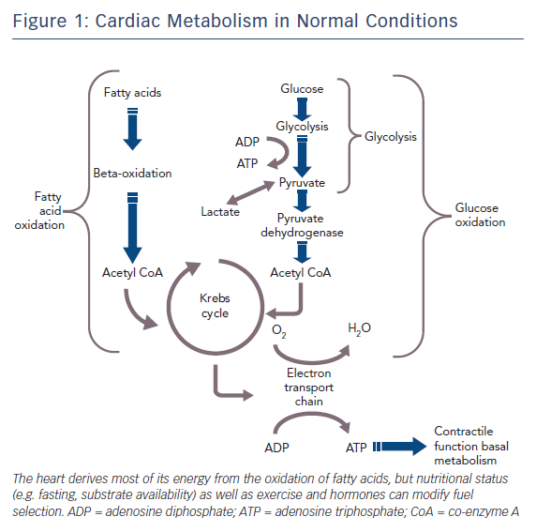
Guarini G, Huqi A, Morrone D, Capozza PFG, Marzilli M
Figure 1: Cardiac Metabolism in Normal Conditions
Citation: European Cardiology Review 2018;13(2):104–11.
https://doi.org/10.15420/ecr.2018.15.2

