Slide 1
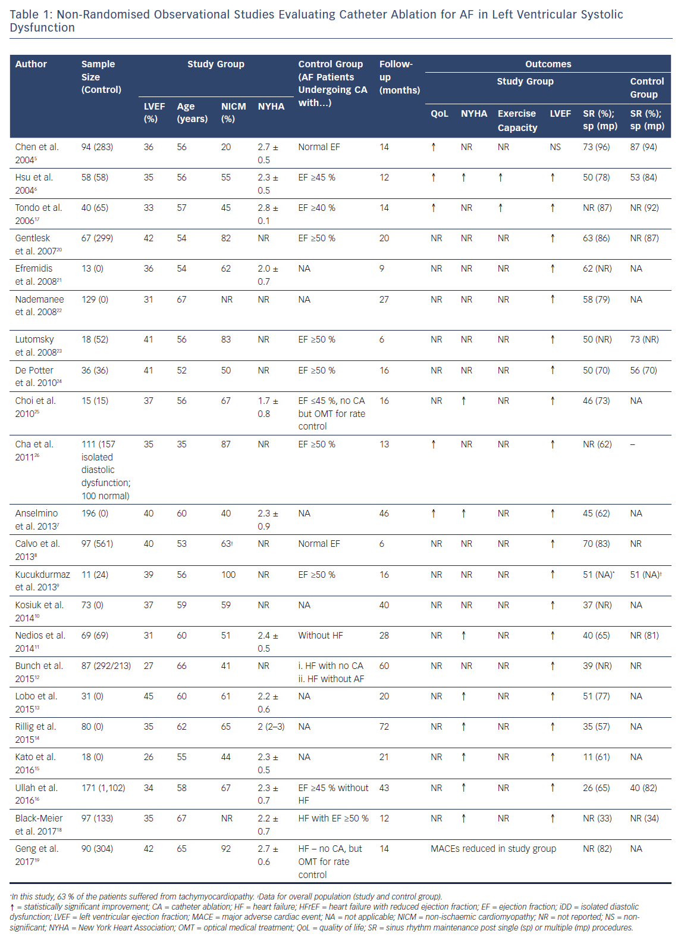
Vrachatis D, Deftereos S, Kekeris V, Tsoukala S, Giannopoulos G
Non-Randomised Observational Studies Evaluating Catheter Ablation for AF in Left Ventricular Systolic Dysfunction
Citation: Arrhythmia & Electrophysiology Review 2018;7(4):265–72.
https://doi.org/10.15420/aer.2018.41.2

