Slide 1
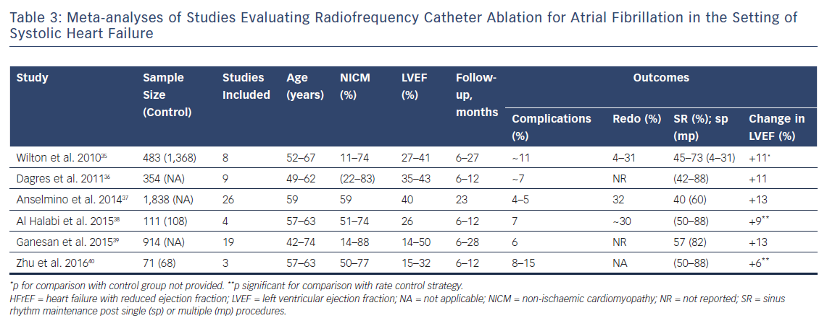
Vrachatis D, Deftereos S, Kekeris V, Tsoukala S, Giannopoulos G
Meta-analyses of Studies Evaluating Radiofrequency Catheter Ablation for Atrial Fibrillation in the Setting of Systolic Heart Failure
Citation: Arrhythmia & Electrophysiology Review 2018;7(4):265–72.
https://doi.org/10.15420/aer.2018.41.2

