Slide 1
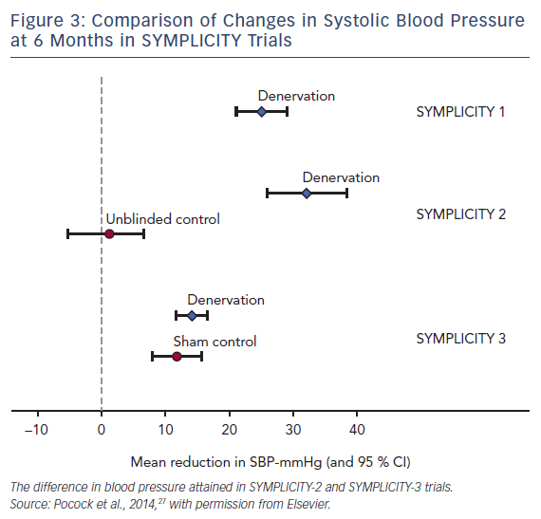
Padmanabhan D, Isath A, Gersh BJ
Comparison of Changes in Systolic Blood Pressure at 6 Months in SYMPLICITY Trials
Citation: US Cardiology Review 2018;12(2):78–86.
https://doi.org/10.15420/usc.2018.1.2

