Slide 1
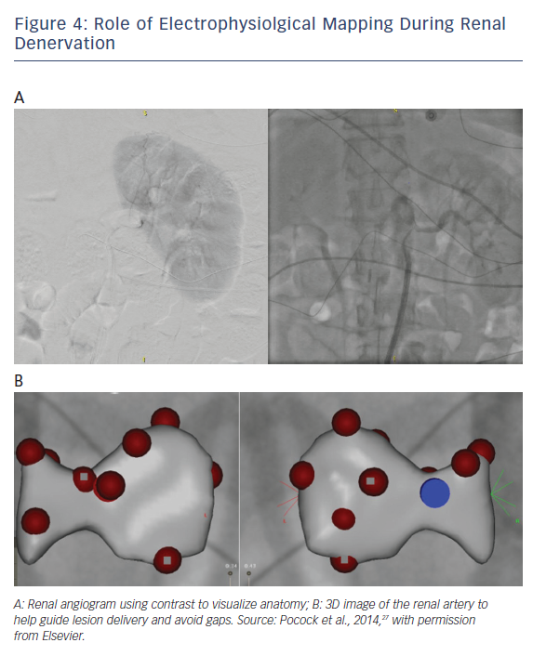
Padmanabhan D, Isath A, Gersh BJ
Role of Electrophysiolgical Mapping During Renal Denervation
Citation: US Cardiology Review 2018;12(2):78–86.
https://doi.org/10.15420/usc.2018.1.2

