Slide 1
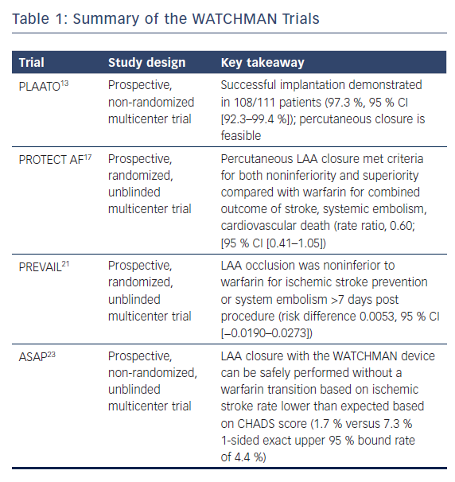
McBride DA, Markman TM, Liang JJ, Santangeli P
Summary of the WATCHMAN Trials
Citation: US Cardiology Review 2018;12(2):87–90.
https://doi.org/10.15420/usc.2018.6.1

