Slide 1

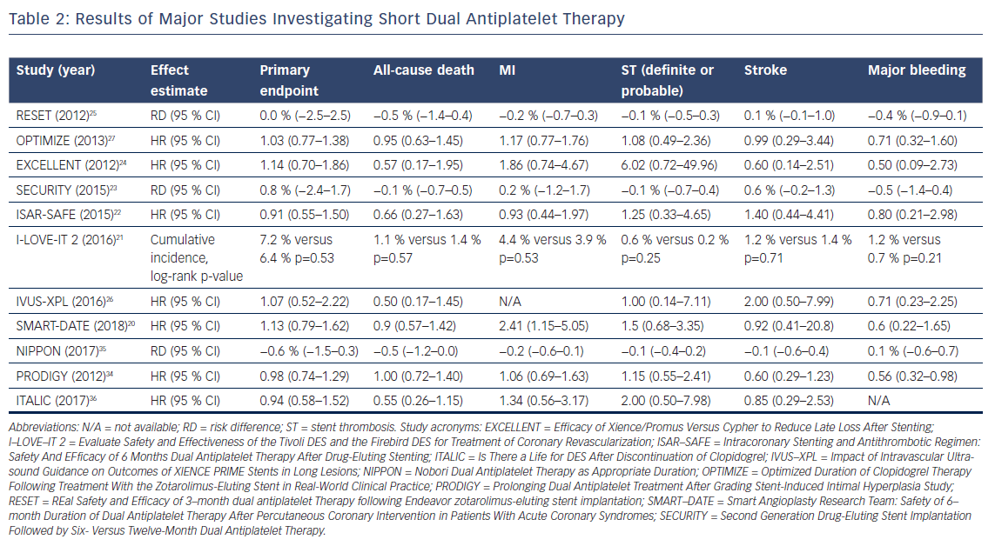
Rozemeijer R, van Bezouwen WP, Voskuil M, Stella P
Results of Major Studies Investigating Short Dual Antiplatelet Therapy
Citation: US Cardiology Review 2018;12(2):91–7.
https://doi.org/10.15420/usc.2018.4.2

