Slide 1
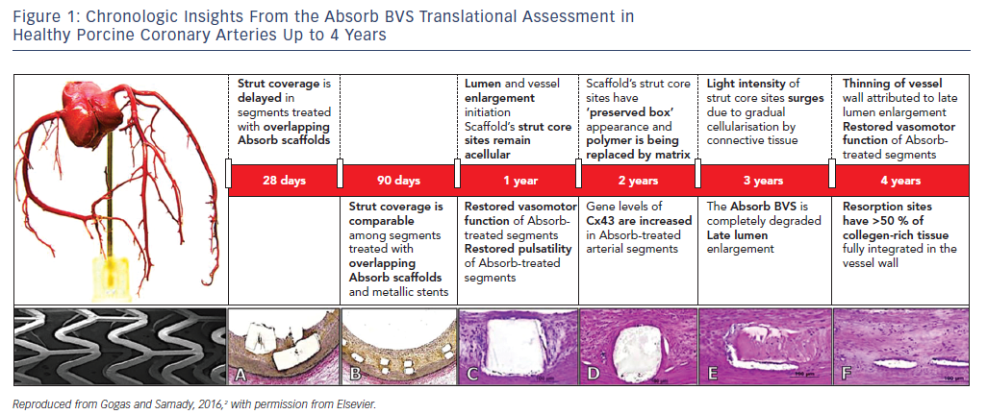
Gogas BD, Zhang JJ, Chen SL
Chronologic Insights From the Absorb BVS Translational Assessment in&lt;br /&gt;&#10;Healthy Porcine Coronary Arteries Up to 4 Years
Citation: US Cardiology Review 2018;12(2):98–102
https://doi.org/10.15420/usc.2018.11.1

