Slide 1
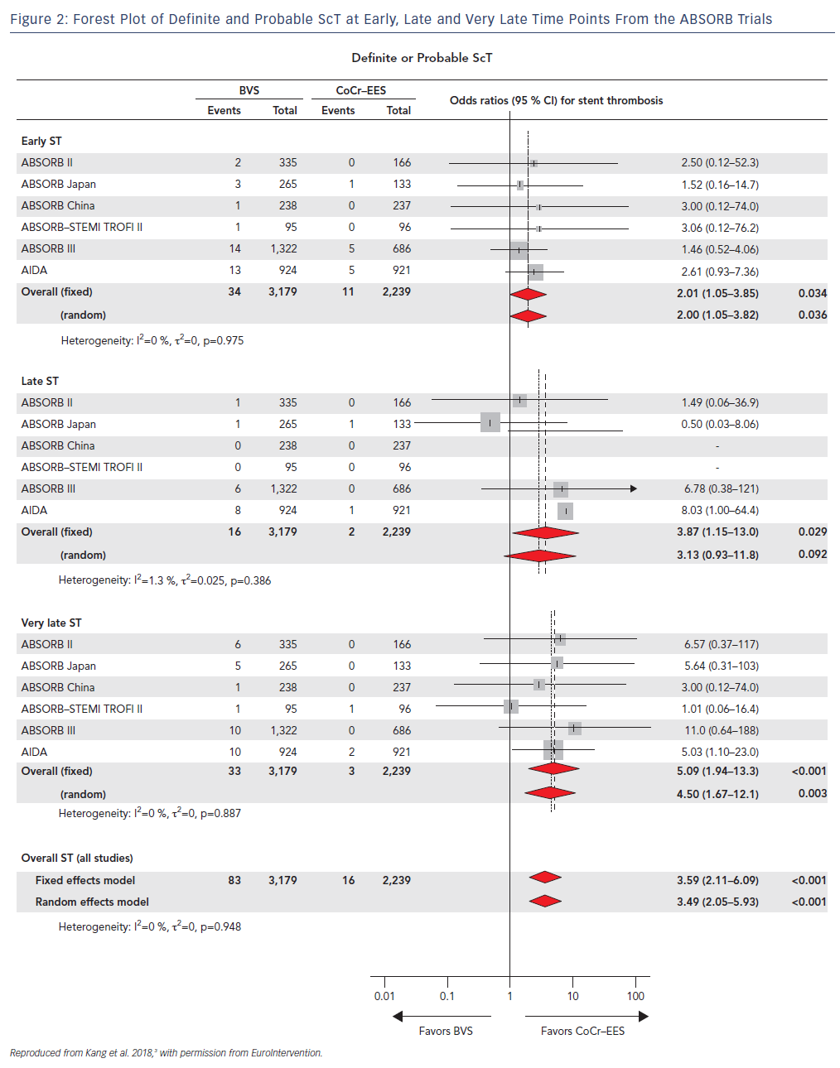
Gogas BD, Zhang JJ, Chen SL
Forest Plot of Definite and Probable ScT at Early, Late and Very Late Time Points From the ABSORB Trials
Citation: US Cardiology Review 2018;12(2):98–102
https://doi.org/10.15420/usc.2018.11.1

