Slide 1
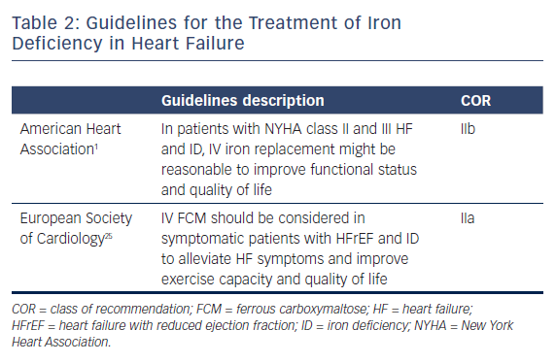
Santhanakrishnan R
Guidelines for the Treatment of Iron Deficiency in Heart Failure
Citation: US Cardiology Review 2018;12(2):110–2.
https://doi.org/10.15420/usc.2017.30.2

