Slide 1
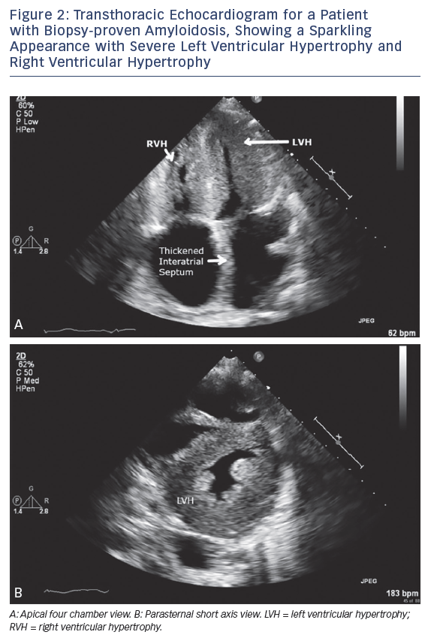
Nemshah Y, Clavijo A, Sharma G
Transthoracic Echocardiogram for a Patient with Biopsy-proven Amyloidosis, Showing a Sparkling Appearance with Severe Left Ventricular Hypertrophy and Right Ventricular Hypertrophy
Citation: US Cardiology Review 2018;12(2):113–8.
https://doi.org/10.15420/usc.2018.5.1

