Slide 1
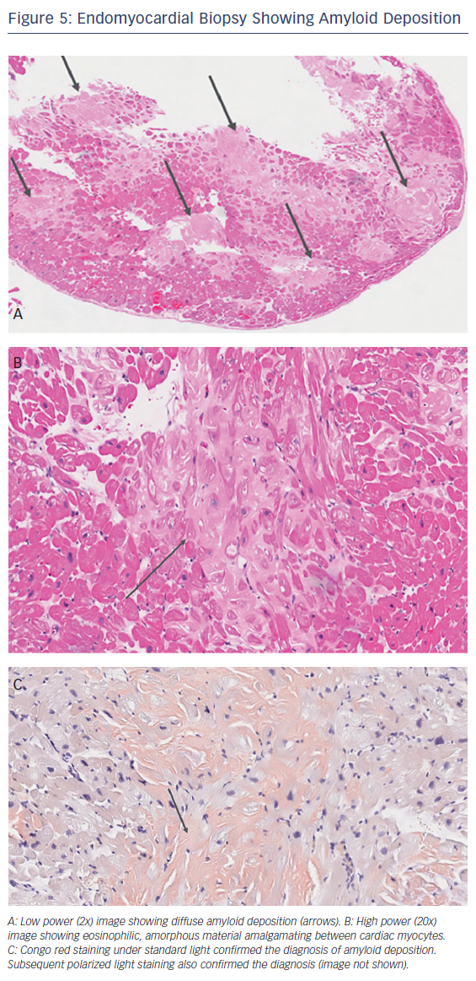
Nemshah Y, Clavijo A, Sharma G
Endomyocardial Biopsy Showing Amyloid Deposition
Citation: US Cardiology Review 2018;12(2):113–8.
https://doi.org/10.15420/usc.2018.5.1

