Slide 1
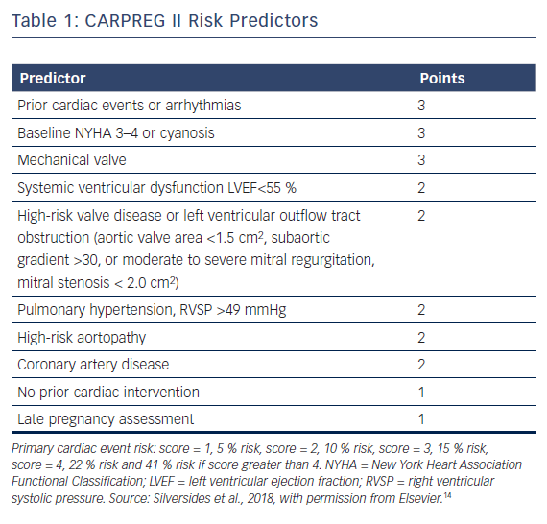
Scott NS
CARPREG II Risk Predictors. CARPEG Score Calculator.
Citation: US Cardiology Review 2018;12(2):119–23.
https://doi.org/10.15420/usc.2018.8.1

