Slide 1
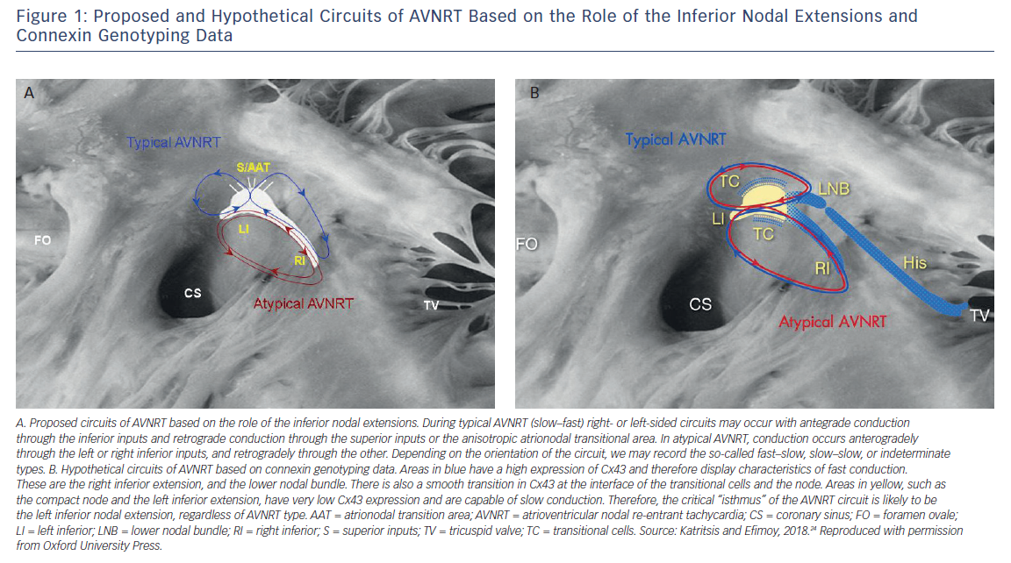
Katritsis DG
Proposed and Hypothetical Circuits of AVNRT Based on the Role of the Inferior Nodal Extensions and Connexin Genotyping Data
Citation: Arrhythmia & Electrophysiology Review 2018;7(4):230–1.
https://doi.org/10.15420/aer.2018.7.4.EO1

