Slide 1
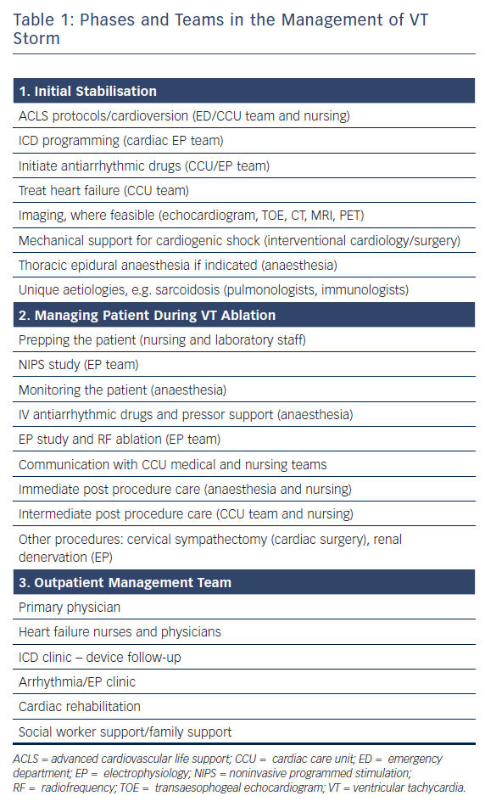
Tang PT, Do DH, Li AC, Boyle NG
Phases and Teams in the Management of VT Storm
Citation: Arrhythmia & Electrophysiology Review 2018;7(4):238–46.
https://doi.org/10.15420/aer.2018.37.2

