Slide 1
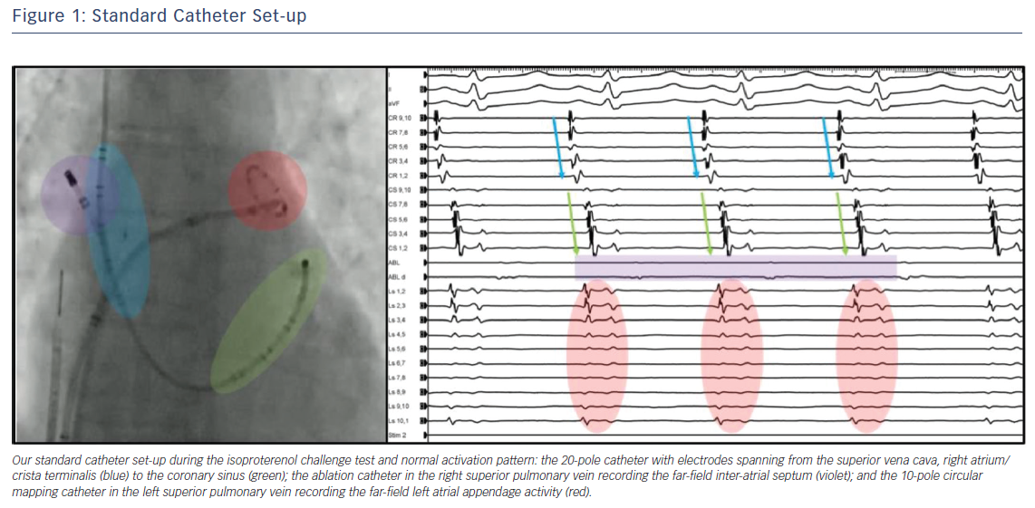
Della Rocca DG, Mohanty S, Trivedi C, Di Biase L, Natale A
Standard Catheter Set-up
Citation: Arrhythmia & Electrophysiology Review 2018;7(4):256–60.
https://doi.org/10.15420/aer.2018.56.2

