Slide 1
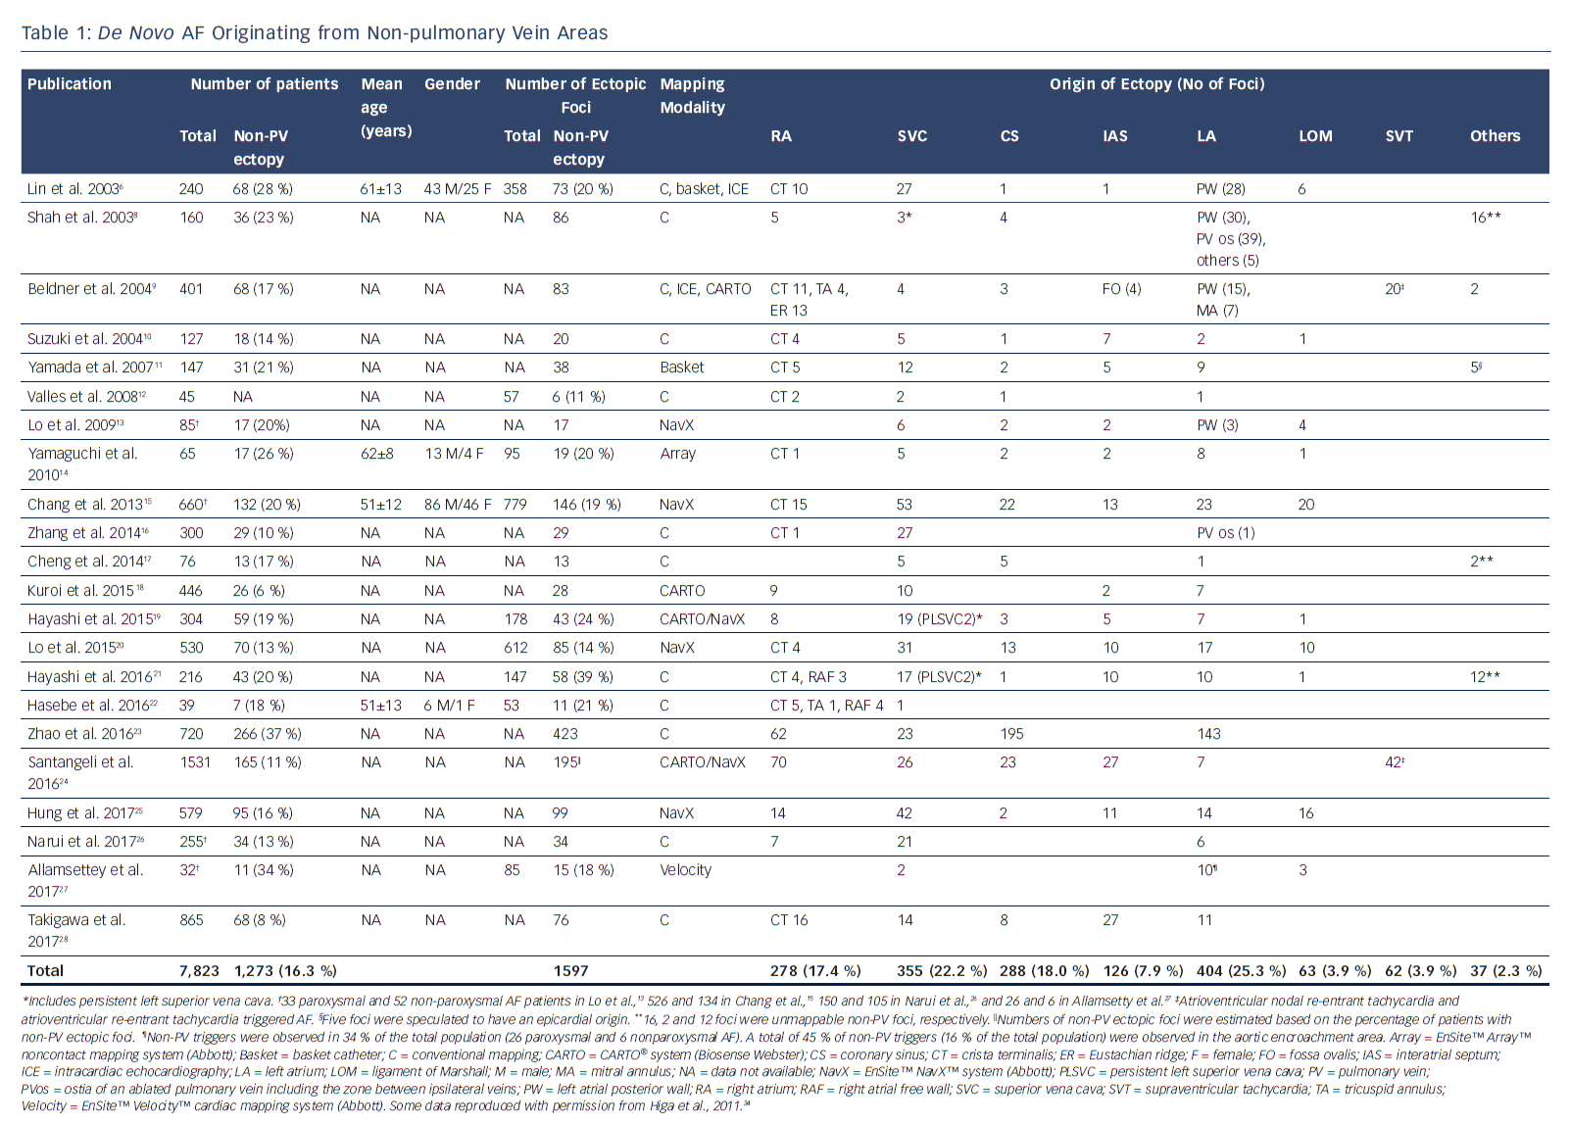
Higa S, Lo LW, Chen SA
De Novo AF Originating from Non-pulmonary Vein Areas
Citation: Arrhythmia & Electrophysiology Review 2018;7(4):273–81.
https://doi.org/10.15420/aer.2018.50.3

