Slide 1
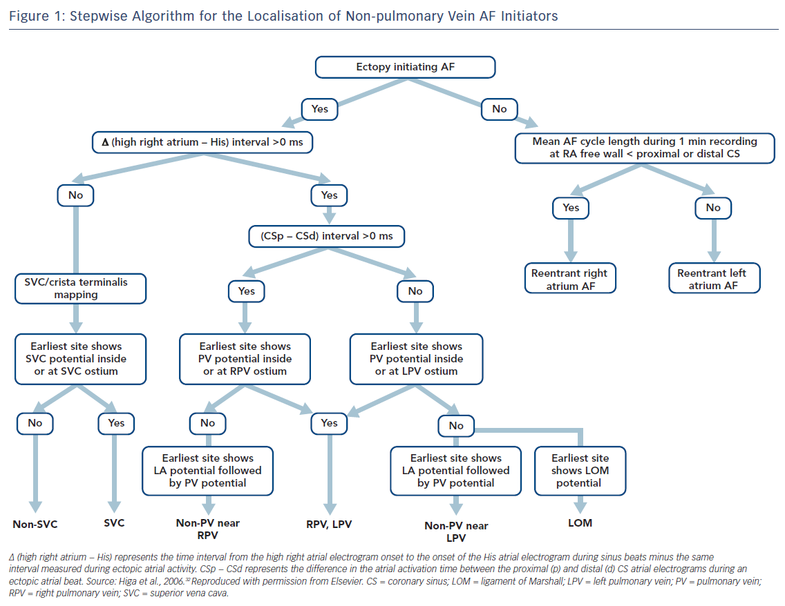
Higa S, Lo LW, Chen SA
Stepwise Algorithm for the Localisation of Non-pulmonary Vein AF Initiators
Citation: Arrhythmia & Electrophysiology Review 2018;7(4):273–81.
https://doi.org/10.15420/aer.2018.50.3

