Slide 1

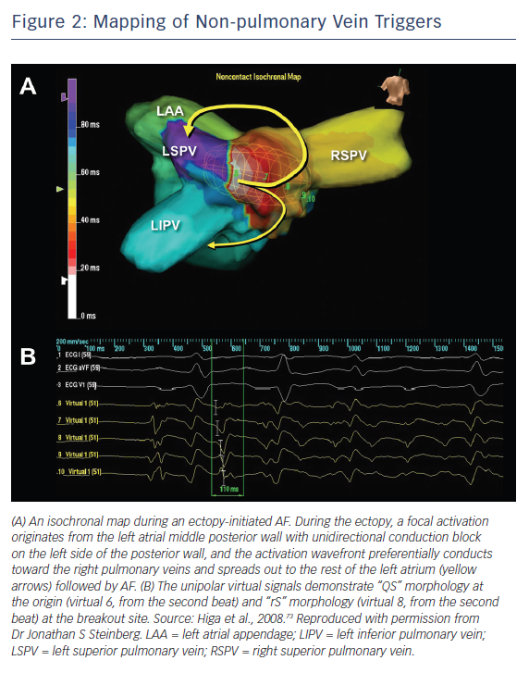
Higa S, Lo LW, Chen SA
Mapping of Non-pulmonary Vein Triggers
Citation: Arrhythmia & Electrophysiology Review 2018;7(4):273–81.
https://doi.org/10.15420/aer.2018.50.3

