Slide 1
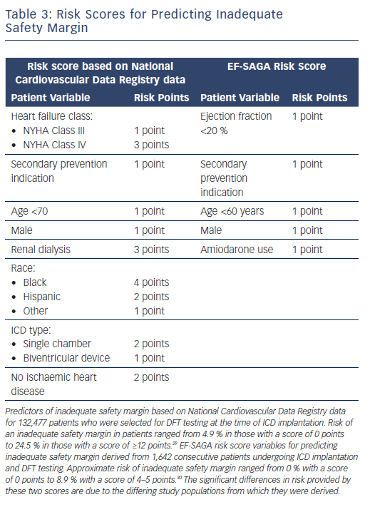
Hayase J, Do DH, Boyle NG
Risk Scores for Predicting Inadequate Safety Margin
Citation: Arrhythmia & Electrophysiology Review 2018;7(4):288–93.
https://doi.org/10.15420/aer.2018.54.2

