Slide 1
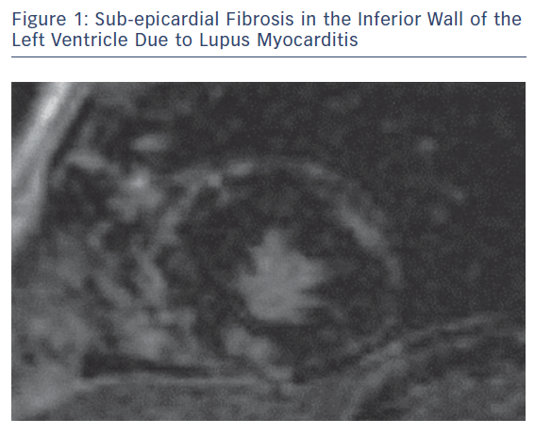
Mavrogeni S, Markousis-Mavrogenis G, Kolovou G
Sub-epicardial Fibrosis in the Inferior Wall
Citation: European Cardiology Review 2018;13(2):95–7.
https://doi.org/10.15420/ecr.2018.19.1

