Slide 1
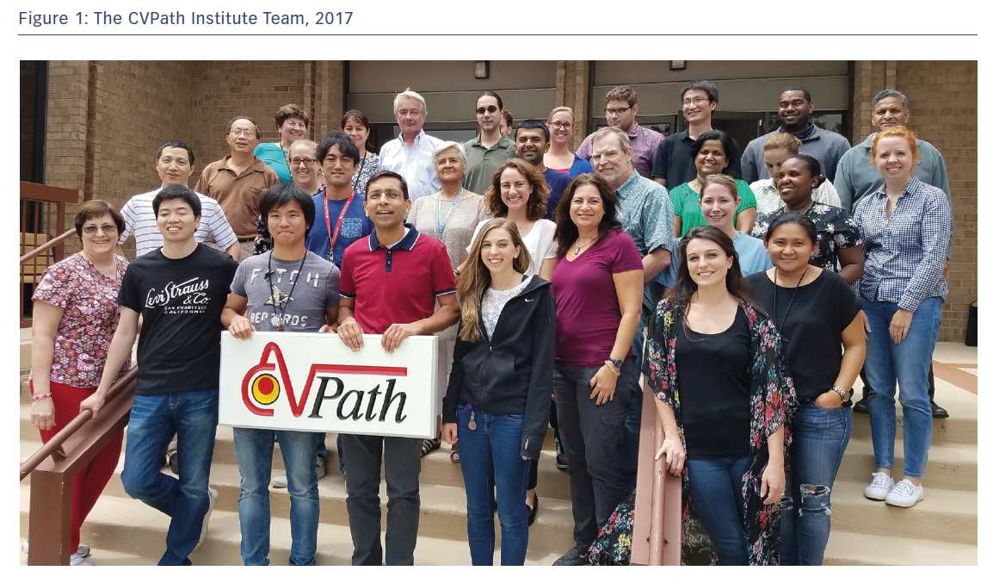
Virmani R
The CVPath Institute Team, 2017
Citation: European Cardiology Review 2018;13(2):134–135.
https://doi.org/10.15420/ecr.13.2.CM2

