Slide 1
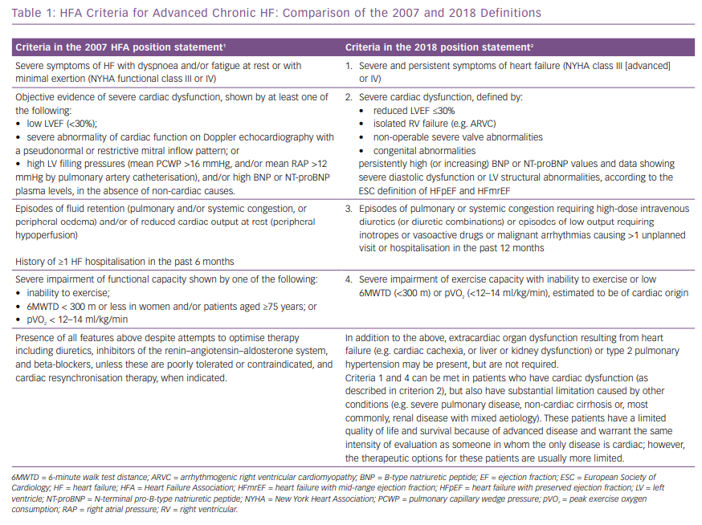
Metra M, Dinatolo E, Dasseni N
HFA Criteria For Advanced Chronic HF: Comparison Of The 2007 And 2018 Definitions
Citation: Cardiac Failure Review 2019;5(1):5–8.
https://doi.org/10.15420/cfr.2018.43.1

