Slide 1
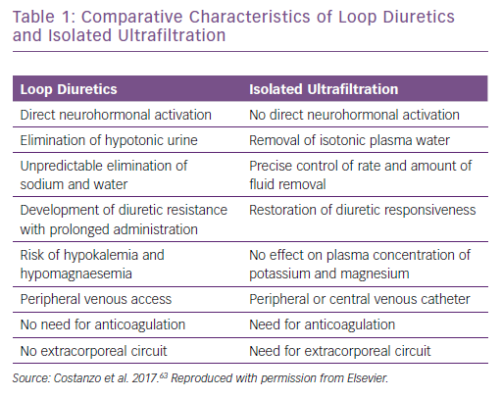
Costanzo MR
Comparative Characteristics of Loop Diuretics&lt;br /&gt;&#10;and Isolated Ultrafiltration
Citation: Cardiac Failure Review 2019;5(1):9–18.
https://doi.org/10.15420/cfr.2018.29.2

