Slide 1
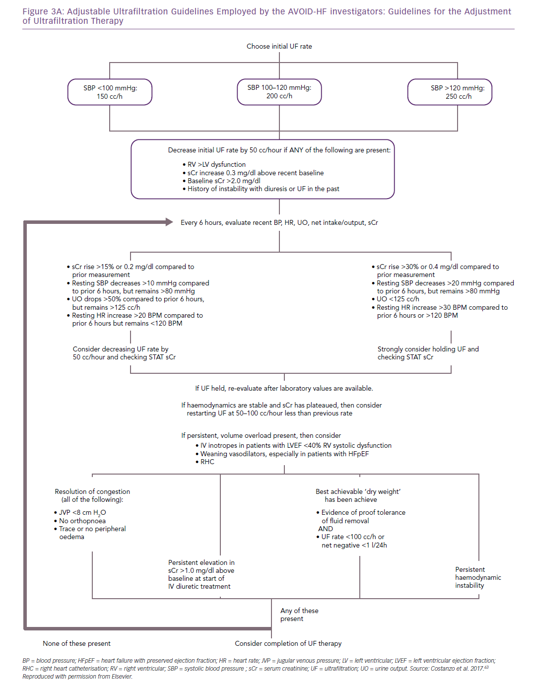
Costanzo MR
Adjustable Ultrafiltration Guidelines Employed by the AVOID-HF investigators: Guidelines for the Adjustment&lt;br /&gt;&#10;of Ultrafiltration Therapy
Citation: Cardiac Failure Review 2019;5(1):9–18.
https://doi.org/10.15420/cfr.2018.29.2

