Slide 1
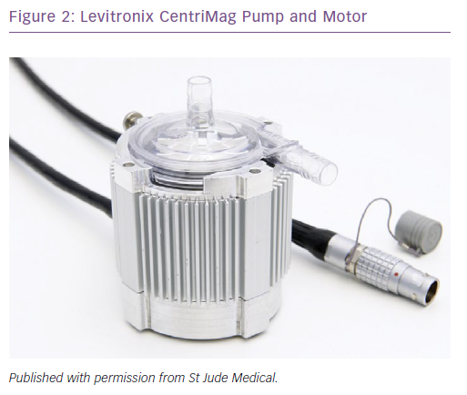
Shehab S, Hayward CS
Levitronix CentriMag Pump and Motor
Citation: Cardiac Failure Review 2019;5(1):19–23.
https://doi.org/10.15420/cfr.2018.23.2

