Slide 1
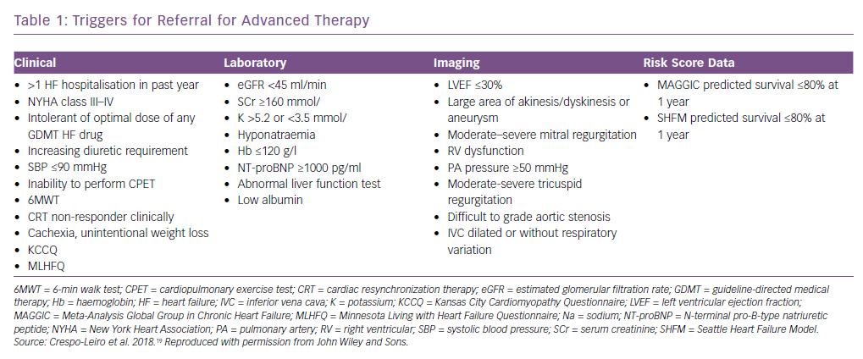
Thorvaldsen T, Lund LH
Triggers for Referral for Advanced Therapy
Citation: Cardiac Failure Review 2019;5(1):24–6.
https://doi.org/10.15420/cfr.2018.35.1

