Slide 1
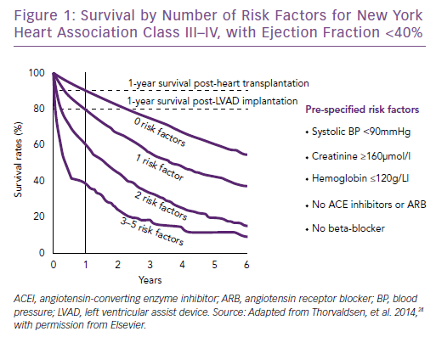
Thorvaldsen T, Lund LH
Survival by Number of Risk Factors for New York&lt;br /&gt;&#10;Heart Association Class III–IV, with Ejection Fraction &lt;40%
Citation: Cardiac Failure Review 2019;5(1):24–6.
https://doi.org/10.15420/cfr.2018.35.1

