Slide 1
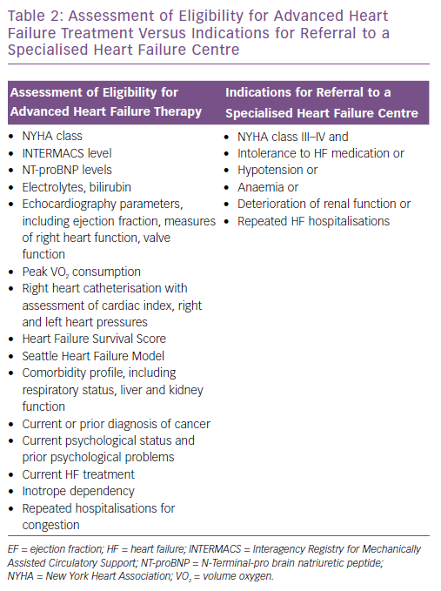
Thorvaldsen T, Lund LH
Assessment of Eligibility for Advanced Heart&lt;br /&gt;&#10;Failure Treatment Versus Indications for Referral to a&lt;br /&gt;&#10;Specialised Heart Failure Centre
Citation: Cardiac Failure Review 2019;5(1):24–6.
https://doi.org/10.15420/cfr.2018.35.1

