Slide 1
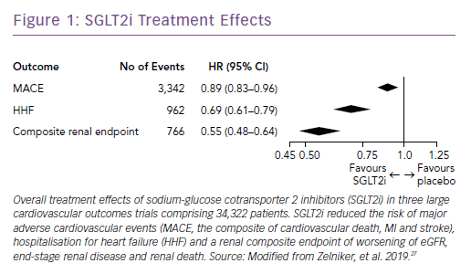
Zelniker TA, Braunwald E
SGLT2i Treatment Effects
Citation: Cardiac Failure Review 2019;5(1):27–30.
https://doi.org/10.15420/cfr.2018.44.1

