Slide 1

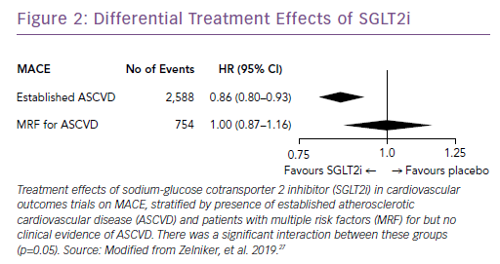
Zelniker TA, Braunwald E
Differential Treatment Effects of SGLT2i
Citation: Cardiac Failure Review 2019;5(1):27–30.
https://doi.org/10.15420/cfr.2018.44.1

