Slide 1
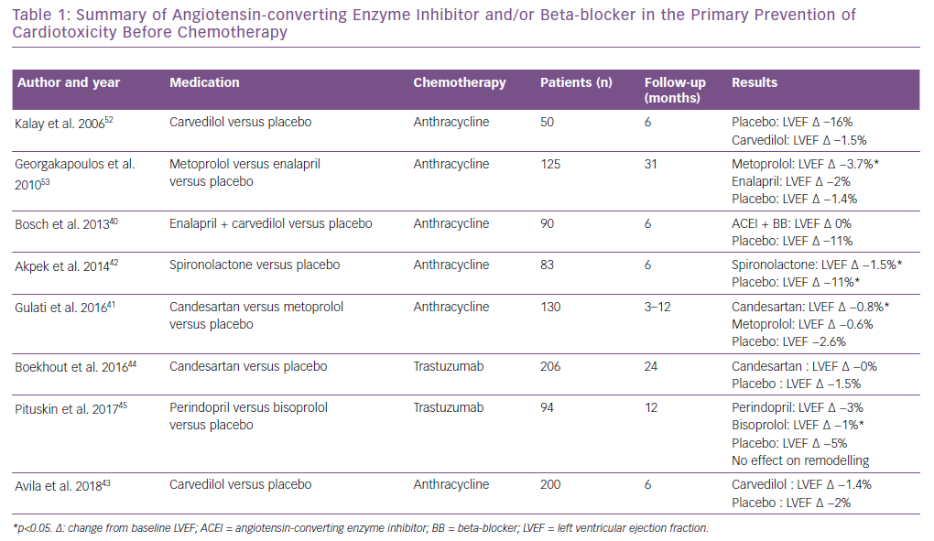
Nicol M, Baudet M, Cohen-Solal A
Summary of Angiotensin-converting Enzyme Inhibitor and/or Beta-blocker in the Primary Prevention of Cardiotoxicity Before Chemotherapy
Citation: Cardiac Failure Review 2019;5(1):31–6.
https://doi.org/10.15420/cfr.2018.25.1

